Slide 1
Internship at TatvaSoft
Name: Vatsal Prakash Bhai Dendpara
Enrollment No: 190203107005
Project ID: 202094
College: Government Engineering College, Rajkot

Slide 2
Company Introduction
Company Name: TatvaSoft a Software Development Company
Tatvasoft is one of the leading global custom software development company with customers.
spanned across 36 countries and working in more than 10 industry domains.
Founded in 2001 by Mr. Manish Patel.
Company is based in Ahmedabad,
over two decades of experience in custom software development services.
successfully catered more than 1800 projects across various technologies and domains.

Slide 3
Internship Learning’s
The goal is to prepare me as a full stack developer.
I got to learn about many frontend and backend Technologies used by professionals for development purpose.
I am doing my activities as intern to be a full stack developer.
Getting and learning the official responsibility to maintain the time and deliver my activities in due time.
My learnings were basically On both backend side frontend side.
Made a whole Project During Internship name Helperland.

Slide 4
Helperland

Slide 5
Introduction
Helperland provides professional Home Cleaning Services, which mean that you don’t have to fret about getting your house cleaned anymore.
service providers i.e. cleaners can register themselves for providing services through the portal and would receive the services booked by the customers.
The other type of users Customers can book the service requests for cleaning and get the job done by one of the service providers from the portal.
Service providers are providers of professional home cleaning services, offering hourly based house cleaning options.

Slide 6
Tools & Technology
Frontend: HTML, CSS, JS, Bootstrap
Backend: PHP MVC
Database: MySQL
Tools: Xammp, Postman
Editor: Visual Studio Code

Slide 7
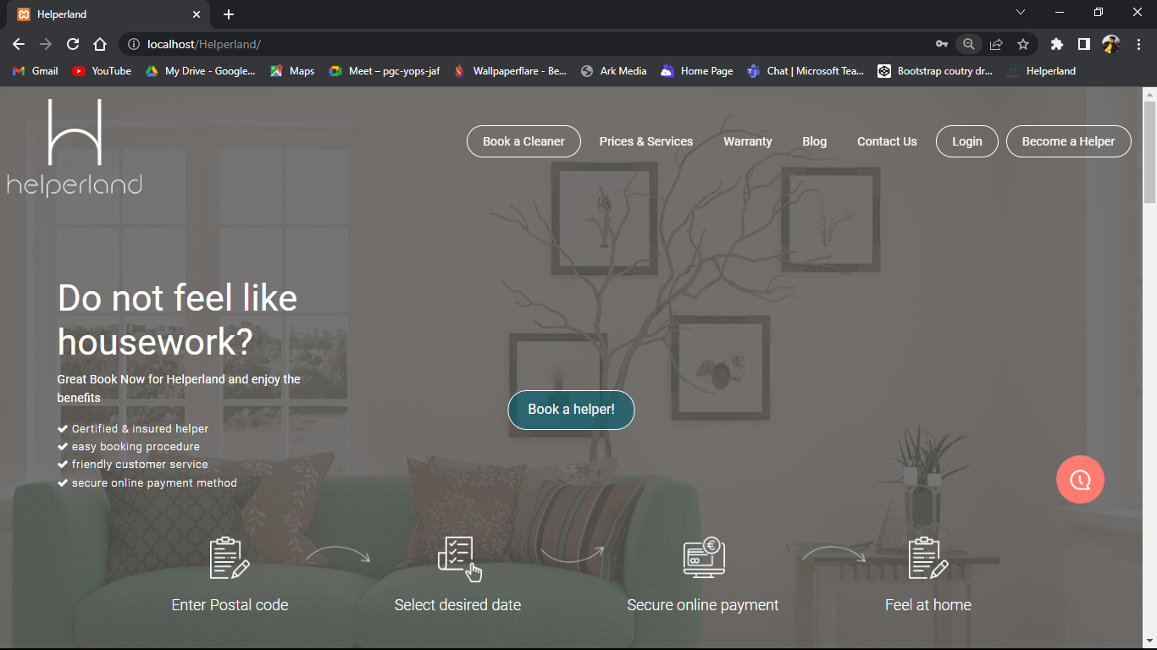
Homepage

Slide 8
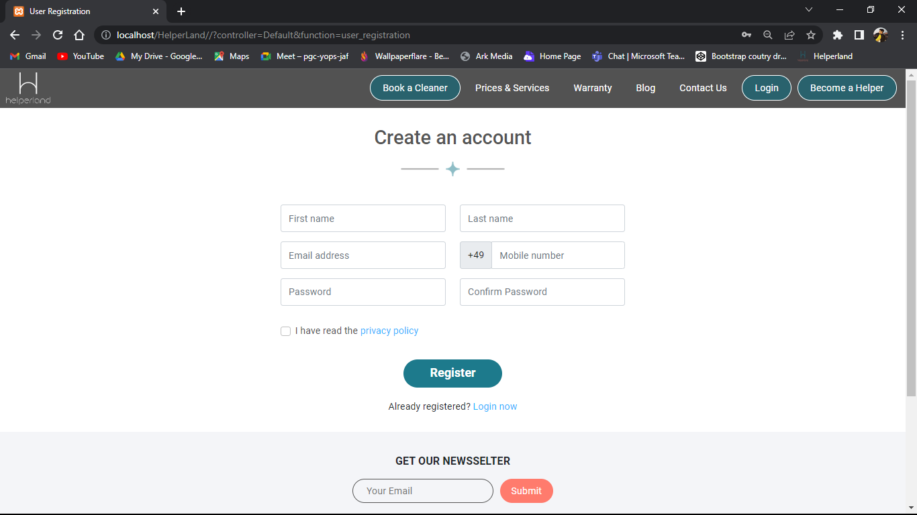
Registration Page for Customer

Slide 9
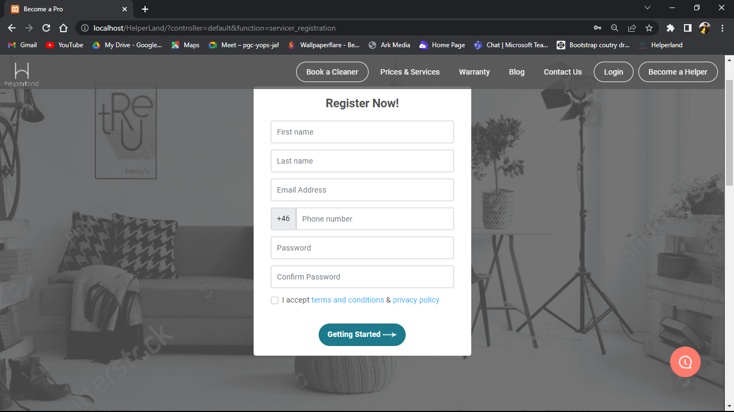
Registration Page for Service Provider

Slide 10
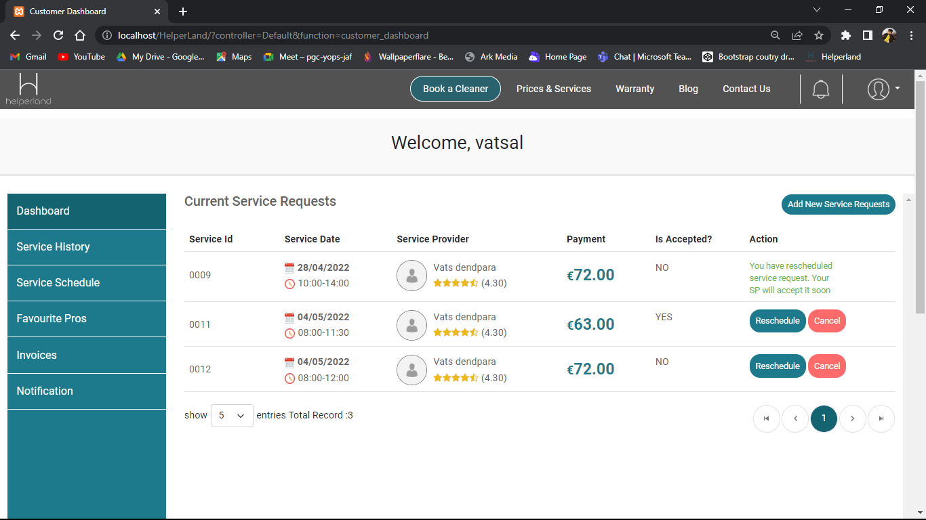
Customer Dashboard

Slide 11
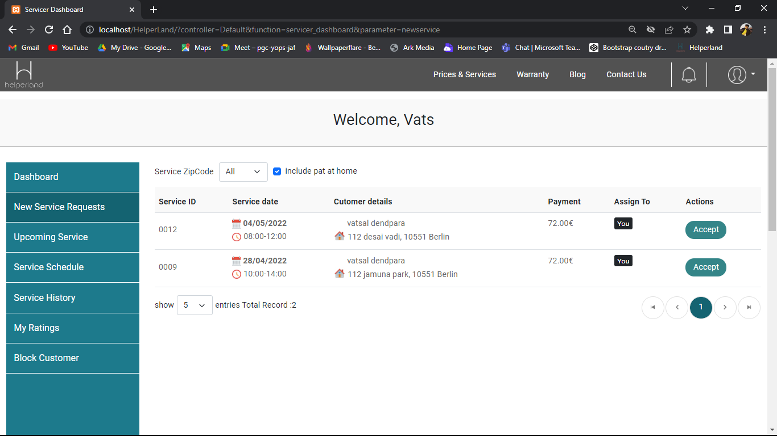
Servicer Dashboard

Slide 12
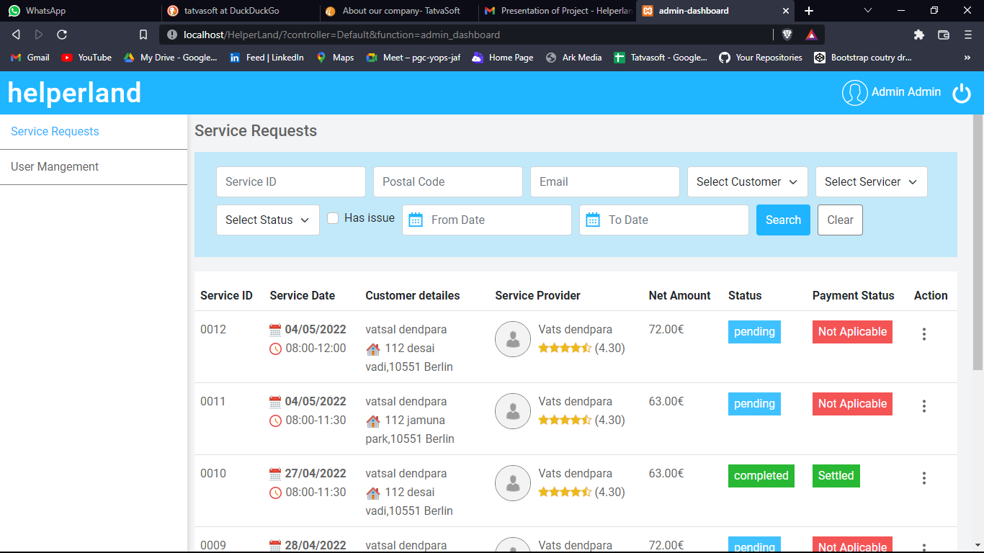
Admin Panel

Slide 13
Thank you..

